Slide 1
Bios 7xx: Deep Learning Methods for Biomedical Applications with Pytorch
Chapter 3. Convolutional Neural Networks (CNN)

Slide 2
Content
1 Introduction to Convolutional Neural Networks (CNN)
2 2D to 3D CNNs
3 Biomedical Application of CNNs
4 Limitations and Challenges in CNNs for Biomedical Data

Slide 3
Content
1 Introduction to Convolutional Neural Networks (CNN)
2 2D to 3D CNNs
3 Biomedical Application of CNNs
4 Limitations and Challenges in CNNs for Biomedical Data

Slide 4
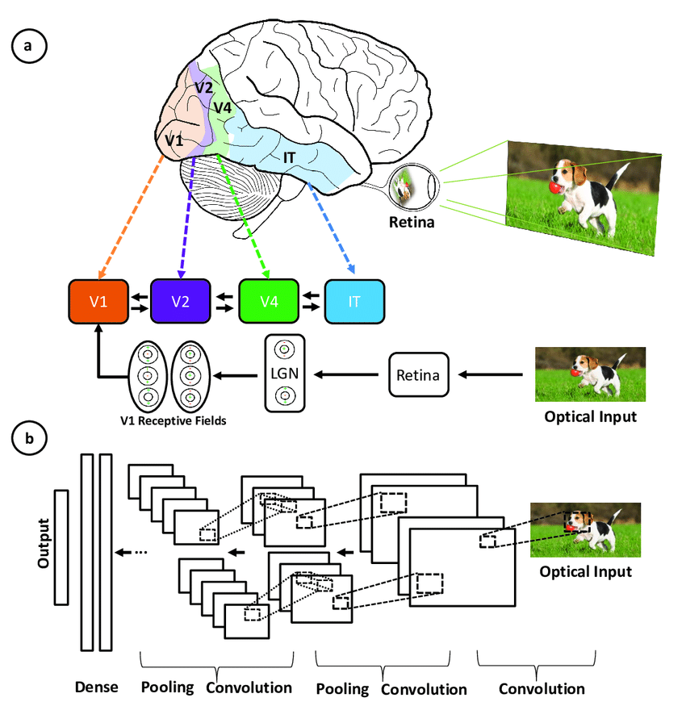
Introduction to Convolutional Neural Networks (CNN)
CNN is is a deep learning algorithm specifically tailored for tasks involving object recognition, such as image classification, detection, and segmentation.
CNNs are used in numerous real-world applications, including self-driving cars, surveillance systems, and more.
Illustration of the correspondence between the areas associated with the primary visual cortex and the layers in a convolutional neural network (source)

Slide 5
Inspiration Behind CNN
CNNs were inspired by the layered architecture of the human visual cortex.
Hierarchical architecture: Both CNNs and the visual cortex have a hierarchical structure, with simple features extracted in early layers and more complex features built up in deeper layers. This allows increasingly sophisticated representations of visual inputs.
Local connectivity: Neurons in the visual cortex only connect to a local region of the input, not the entire visual field. Similarly, the neurons in a CNN layer are only connected to a local region of the input volume through the convolution operation. This local connectivity enables efficiency.
Illustration of the correspondence between the areas associated with the primary visual cortex and the layers in a convolutional neural network (source)

Slide 6
Inspiration Behind CNN
Translation invariance: Similar to visual cortex neurons can detect features regardless of their location in the visual field, pooling layers in a CNN provide a degree of translation invariance by summarizing local features.
Multiple feature maps: At each stage of visual processing, there are many different feature maps extracted. CNNs mimic this through multiple filter maps in each convolution layer.
Non-linearity: Neurons in the visual cortex exhibit non-linear response properties. CNNs achieve non-linearity through activation functions like ReLU applied after each convolution.
Illustration of the correspondence between the areas associated with the primary visual cortex and the layers in a convolutional neural network (source)

Slide 7
Understanding Invariance in Neural Networks
What is Invariance?
Invariance refers to properties or quantities that remain unchanged under certain transformations or operations.
In the context of deep learning, invariance refers to a model's ability to recognize patterns regardless of certain transformations (e.g. Translation (shifting), Rotation, Scaling), as the model's output remains unchanged under certain transformations of the input.
Why is Invariance Important?
Aids in simplifying complex problems by focusing on constant factors.
Real-world objects may appear in different positions, orientations, or scales.
Models should recognize objects regardless of these variations.
Limitations of Fully Connected Networks (MLPs)
Do not inherently handle spatial hierarchies in data.
Lack of invariance to translations and other transformations.

Slide 8
How Invariance Inspires CNN Architecture
Convolutional Layers and Weight Sharing
Convolutional layers apply the same filter across different spatial locations.
Weight sharing reduces the number of parameters and captures local patterns.
Translation Invariance
Convolutions allow the detection of features regardless of their position.
Pooling layers further enhance invariance by summarizing nearby outputs.
Benefits for Visual Tasks
Efficiently recognize objects in varied contexts.
Improve generalization by focusing on relevant features.

Slide 9
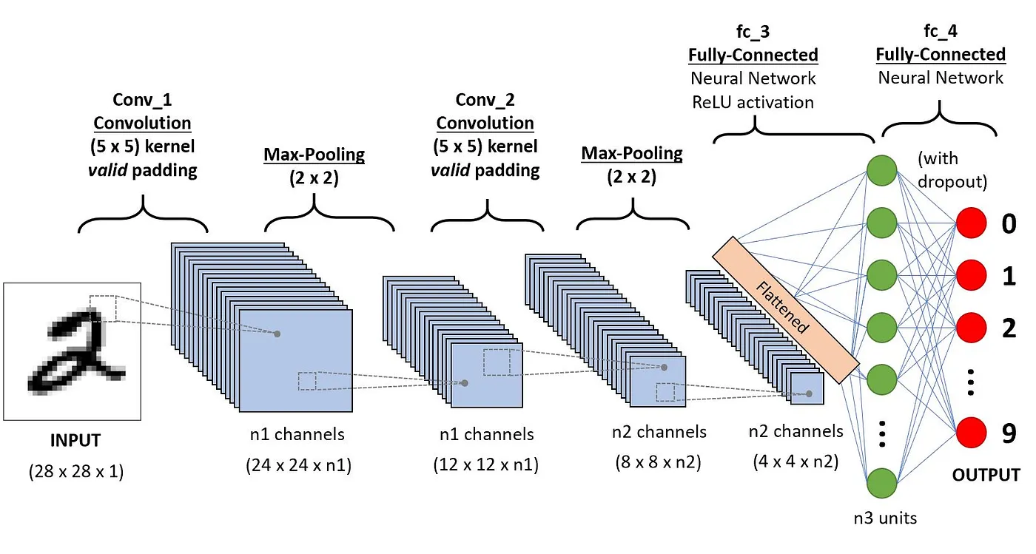
Key Components of CNN
Convolutional layers
Rectified Linear Unit (ReLU)
Pooling layers
Fully connected layers
Illustration of architecture of CNNs applied to digit recognition (source)

Slide 10
Feature Extraction Using Convolution
Input, kernel, and output (right figure)
Fully Connected Networks
“fully connect” all the hidden units to all the input units. Only computationally feasible to learn features on the entire image for relatively small images.
order of 10⁶ parameters to learn for 96x96 images. The feedforward and backpropagation computations would also be about 100 times slower, compared to 28x28 images.
Locally Connected Networks
Illustration of Discrete 2D Convolution (source)

Slide 11
Feature Extraction Using Convolution
Input, kernel, and output (right figure)
Fully Connected Networks
Locally Connected Networks
A simple solution to this problem is to limit connections between hidden and input units, allowing each hidden unit to connect to only a small subset of input units, such as a contiguous region of pixels. For other data types different than images like audio, hidden units can be connected to specific time spans. This concept of local connections is inspired by the visual cortex, where neurons respond to stimuli in specific locations.
Illustration of Discrete 2D Convolution (source)

Slide 12
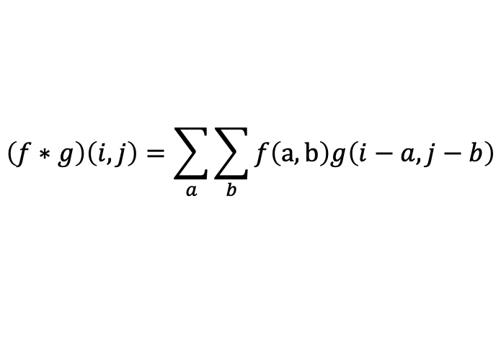
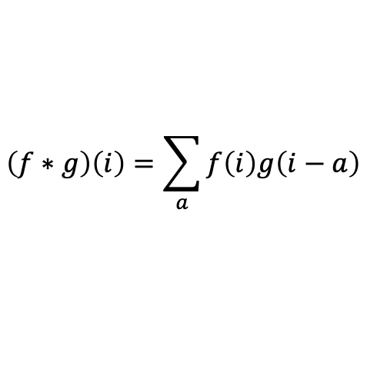
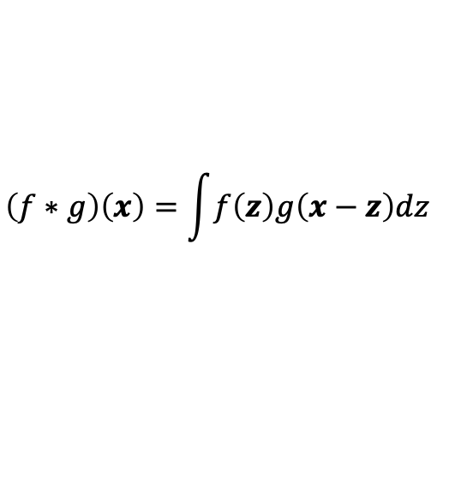
Understanding the Convolution Operation
What is convolution?
Mathematically, Convolution is defined as$f,g: ℝ^{n}→ℝ$ :
$$\left(f∗g\right)\left(x\right)=\int{f\left(z\right)g\left(x−z\right)dz}$$
Whenever we have discrete objects, the integral turns into a sum. For instance, in CNN, we used discrete convolution for vectors from the set of square-summable infinite-dimensional vectors defined as:
$$\left(f∗g\right)\left(i\right)=\sum_{a}{f\left(i\right)g\left(i−a\right)}$$
For two-dimensional tensors, we have a corresponding sum with (a,b) for f (i-a,j-b) for g, respectively:
$$\left(f∗g\right)\left(i,j\right)=\sum_{a}{\sum_{b}{f\left(a,b\right)g\left(i−a,j−b\right)}}$$

Slide 13
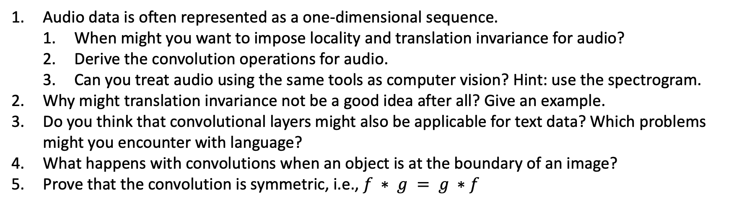
Exercises
Audio data is often represented as a one-dimensional sequence.
When might you want to impose locality and translation invariance for audio?
Derive the convolution operations for audio.
Can you treat audio using the same tools as computer vision? Hint: use the spectrogram.
Why might translation invariance not be a good idea after all? Give an example.
Do you think that convolutional layers might also be applicable for text data? Which problems might you encounter with language?
What happens with convolutions when an object is at the boundary of an image?
Prove that the convolution is symmetric, i.e., $f ∗ g = g ∗f$

Slide 14
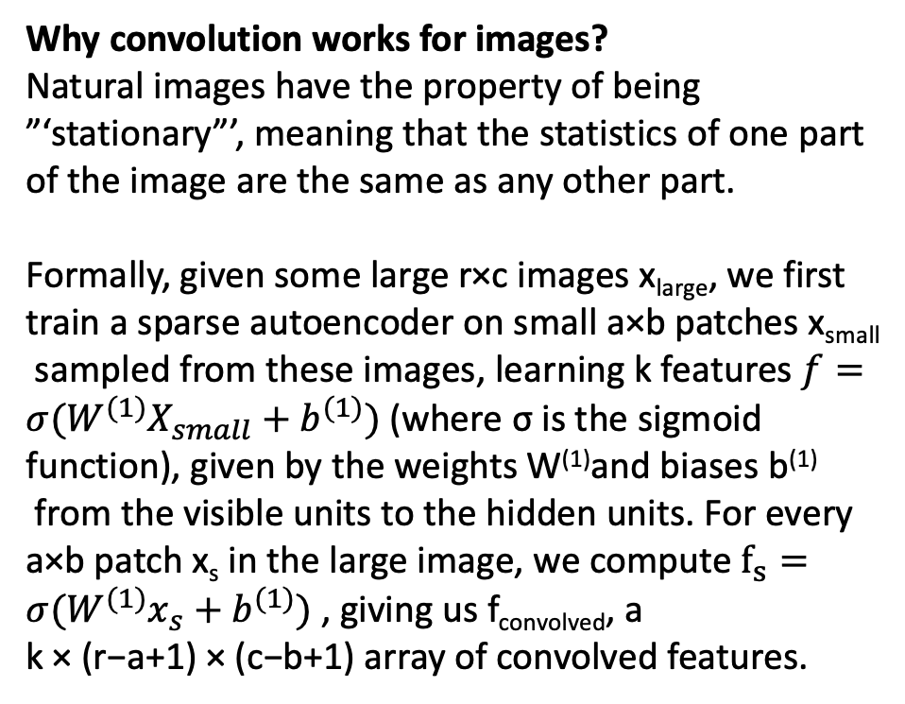
Understanding the Convolution Operation
Why convolution works for images?
Natural images have the property of being ”‘stationary”’, meaning that the statistics of one part of the image are the same as any other part.
Formally, given some large r×c images x_{large}, we first train a sparse autoencoder on small a×b patches x_{small}
sampled from these images, learning k features $f=σ(W^{(1)}X_{small}+b^{(1)})$ (where σ is the sigmoid function), given by the weights W⁽¹⁾and biases b⁽¹⁾
from the visible units to the hidden units. For every a×b patch x_{s} in the large image, we compute $f_{s}=σ(W^{(1)}x_{s}+b^{(1)})$ , giving us f_{convolved}, a
k × (r−a+1) × (c−b+1) array of convolved features.
Illustration of Discrete 2D Convolution (source)

Slide 15
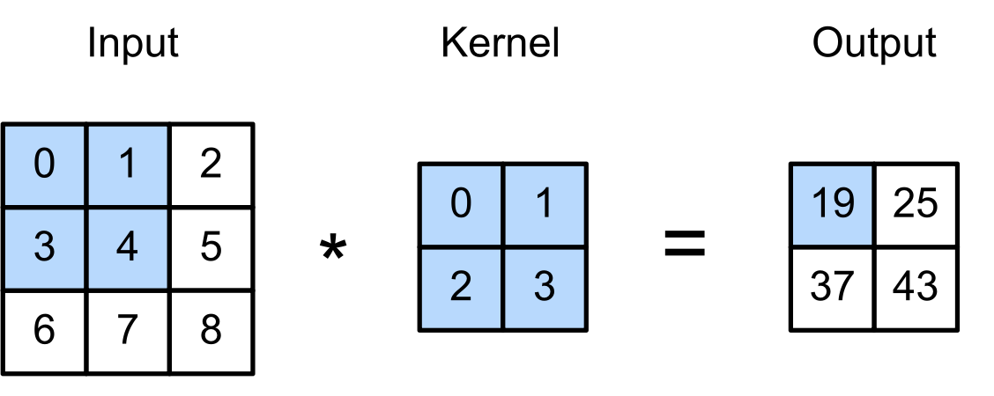
Cross-Correlation Operation
In practice, convolution operations in CNN can be more accurately described as cross-correlations. In each convolution layer, an input tensor and a kernel tensor are combined to produce an output tensor through a cross-correlation operation.
Consider example:

Slide 16
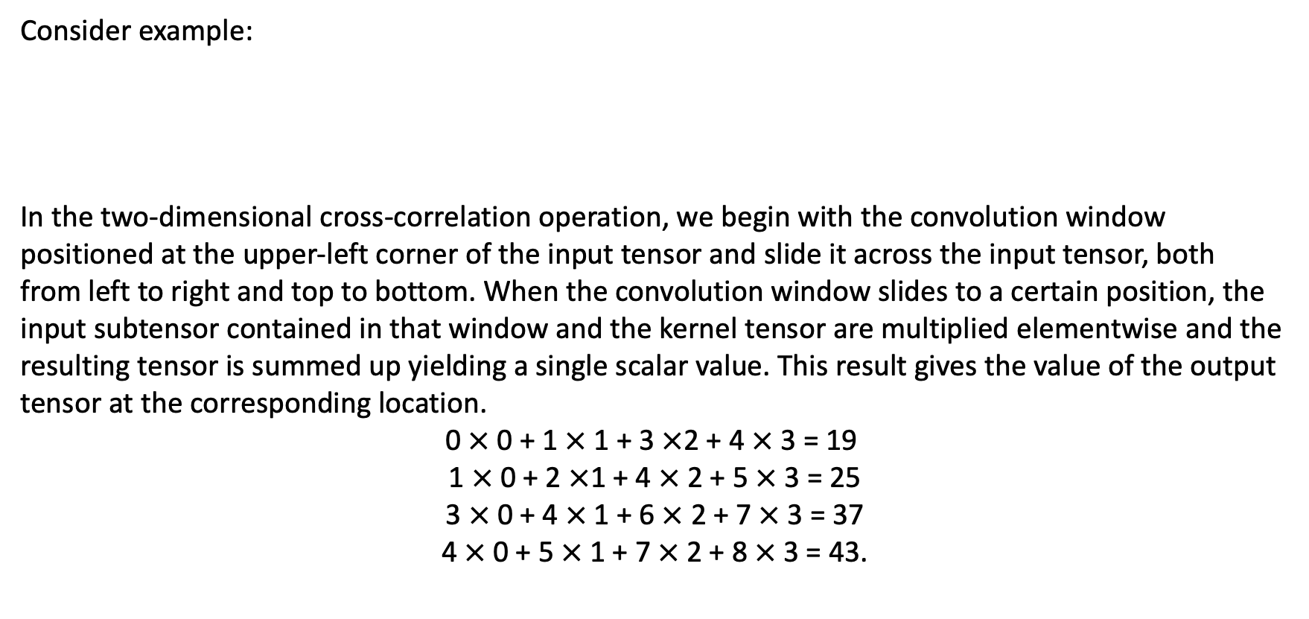
Cross-Correlation Operation
Consider example:
In the two-dimensional cross-correlation operation, we begin with the convolution window positioned at the upper-left corner of the input tensor and slide it across the input tensor, both from left to right and top to bottom. When the convolution window slides to a certain position, the input subtensor contained in that window and the kernel tensor are multiplied elementwise and the resulting tensor is summed up yielding a single scalar value. This result gives the value of the output tensor at the corresponding location.
$$\text{0} × \text{0} \text{+} \text{1} × \text{1} \text{+} \text{3} ×\text{2} \text{+} \text{4} × \text{3} \text{=} \text{19}$$
$$\text{ 1} × \text{0} \text{+} \text{2} ×\text{1} \text{+} \text{4} × \text{2} \text{+} \text{5} × \text{3} \text{=} \text{25}$$
$$\text{ 3} × \text{0} \text{+} \text{4} × \text{1} \text{+} \text{6} × \text{2} \text{+} \text{7} × \text{3} \text{=} \text{37}$$
$$\text{ 4} × \text{0} \text{+} \text{5} × \text{1} \text{+} \text{7} × \text{2} \text{+} \text{8} × \text{3} \text{=} \text{43.}$$

Slide 17
Cross-Correlation Operation
Note that along each axis, the output size is slightly smaller than the input size. Because the kernel has width and height greater than
1, we can only properly compute the cross-correlation for locations where the kernel fits wholly within the image.
Exercise:
Show that if convolution kernel size = 0, the convolution kernel implements an MLP independently for each set of channels. (Lin, M., Chen, Q., & Yan, S. (2013). Network in network. ArXiv:1312.4400. )
import torch
def corr2d(X, K):
"""Compute 2D cross-correlation."""
h, w = K.shape
Y = torch.zeros((X.shape[0] - h + 1, X.shape[1] - w + 1))
for i in range(Y.shape[0]):
for j in range(Y.shape[1]):
Y[i, j] = (X[i:i + h, j:j + w] * K).sum()
return Y
Illustration of Discrete 2D Convolution (source)

Slide 18
Convolutional Layers
A convolutional layer cross-correlates the input and kernel and adds a scalar bias to produce an output. The two parameters of a convolutional layer are the kernel and the scalar bias. When training models based on convolutional layers, we typically initialize the kernels randomly.
We can implement a two-dimensional convolutional layer based on the corr2d function defined above. In the __init__ constructor method, we declare weight and bias as the two model parameters. The forward propagation method calls the corr2d function and adds the bias.
import torch
class Conv2D(nn.Module):
def __init__(self, kernel_size):
super().__init__()
self.weight = nn.Parameter(torch.rand(kernel_size))
self.bias = nn.Parameter(torch.zeros(1))
def forward(self, x):
return corr2d(x, self.weight) + self.bias
Illustration of Discrete 2D Convolution (source)

Slide 19
Padding, Stride, and Pooling
Padding
Zero-padding and why it's necessary (The pixels at the corner in the previous images are less counted than those in the middle)
How padding affects the dimensions of the output
Illustration of padding effects (source)

Slide 20
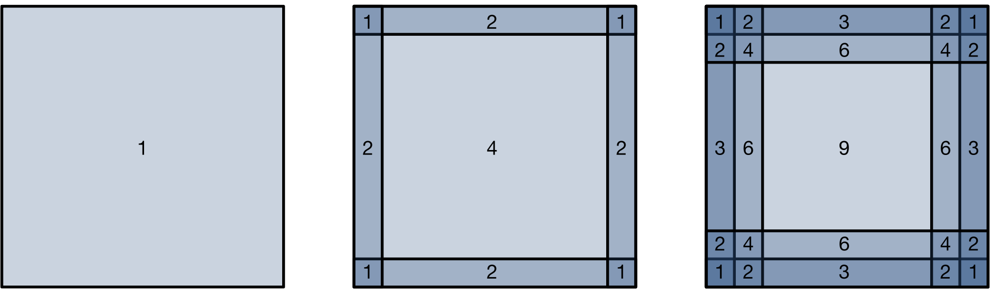
Padding
One tricky issue when applying convolutional layers is that we tend to lose pixels on the perimeter of our image. The following figure depicts the pixel utilization as a function of the convolution kernel size and the position within the image.
We can see that the pixels in the corners are hardly used at all.
Pixel utilization for convolutions of 1x1, 2x2, and 3x3 respectively.

Slide 21
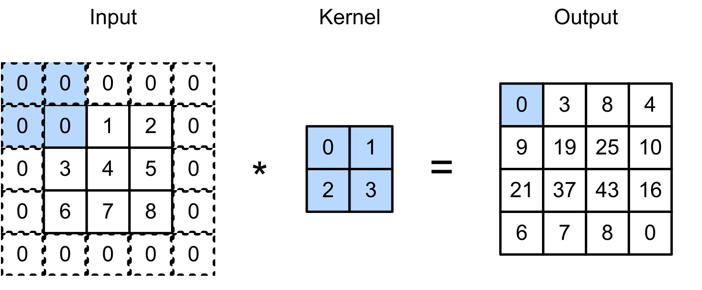
Padding
One straightforward solution to this problem is to add extra pixels of filler around the boundary of our input image, thus increasing the effective size of the image. Typically, we set the values of the extra pixels to zero.
Example padding 3x3 input to 5x5 matrix:

Slide 22
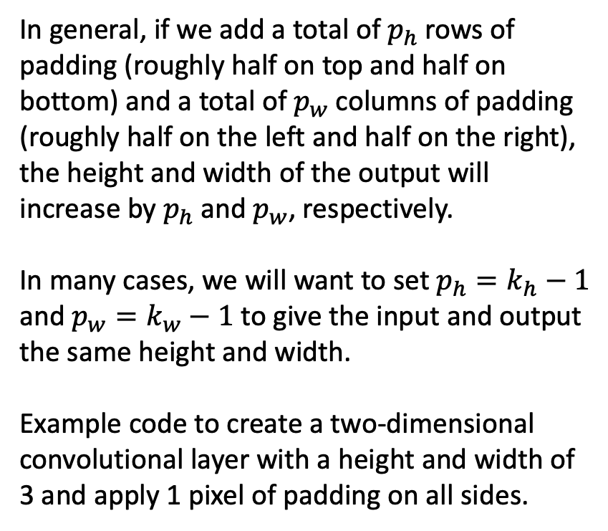
Padding
from torch import nn
# We define a helper function to calculate convolutions. It initializes the
# convolutional layer weights and performs corresponding dimensionality
# elevations and reductions on the input and output
def comp_conv2d(conv2d, X):
# (1, 1) indicates that batch size and the number of channels are both 1
X = X.reshape((1, 1) + X.shape)
Y = conv2d(X)
# Strip the first two dimensions: examples and channels
return Y.reshape(Y.shape[2:])
# 1 row and column is padded on either side, so a total of 2 rows or columns are added
conv2d = nn.LazyConv2d(1, kernel_size=3, padding=1)
X = torch.rand(size=(8, 8))
comp_conv2d(conv2d, X).shape
In general, if we add a total of $p_{h}$rows of padding (roughly half on top and half on bottom) and a total of $p_{w}$ columns of padding (roughly half on the left and half on the right), the height and width of the output will increase by $p_{h}$ and $p_{w}$, respectively.
In many cases, we will want to set $p_{h}=k_{h}−1$ and $p_{w}=k_{w}−1$to give the input and output the same height and width.
Example code to create a two-dimensional convolutional layer with a height and width of 3 and apply 1 pixel of padding on all sides.
Illustration of Discrete 2D Convolution (source)

Slide 23
Padding, Stride, and Pooling
Stride
How stride affects output size
Example with stride of 1 vs. 2
Illustration Convolution Operation with Stride Length = 1 Vs 2 (source)

Slide 24
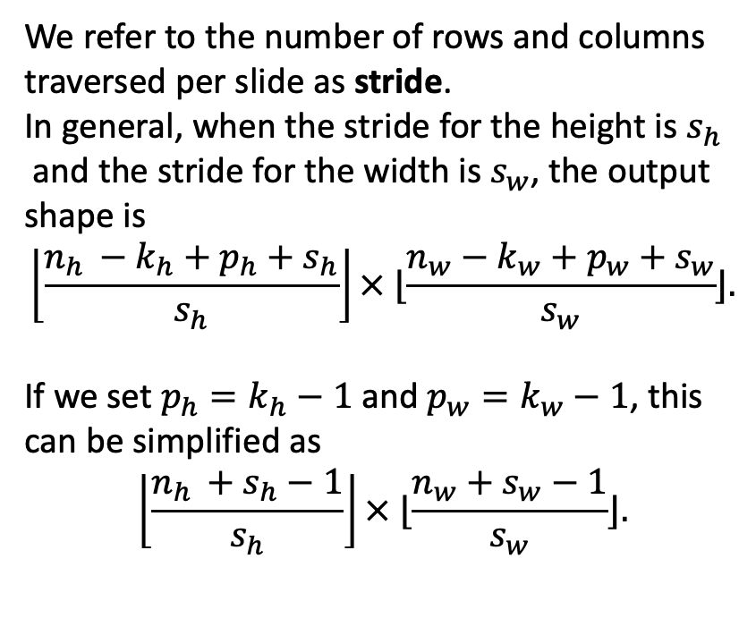
Stride
We refer to the number of rows and columns traversed per slide as stride.
In general, when the stride for the height is $s_{h}$
and the stride for the width is $s_{w}$, the output shape is
$$\left\lfloor \frac{n_{h }−k_{h}+p_{h}+s_{h}}{s_{h}}\right\rfloor × ⌊\frac{n_{w}−k_{w}+p_{w}+s_{w}}{s_{w}}⌋.$$
If we set $p_{h}=k_{h}−1$ and $p_{w}=k_{w}−1$, this can be simplified as
$$\left\lfloor \frac{n_{h }+s_{h}−1}{s_{h}}\right\rfloor × ⌊\frac{n_{w}+s_{w}−1}{s_{w}}⌋.$$
from torch import nn
# Using same example 8x8 matrix X
# If we set the strides on both the height and width to 2, thus halving the input height and width.
conv2d = nn.LazyConv2d(1, kernel_size=3, padding=1, stride=2)
comp_conv2d(conv2d, X).shape
# torch.Size([4, 4])
# A slightly more complicated example.
conv2d = nn.LazyConv2d(1, kernel_size=(3, 5), padding=(0, 1), stride=(3, 4))
comp_conv2d(conv2d, X).shape
# torch.Size([2, 2])
Illustration of Discrete 2D Convolution (source)

Slide 25
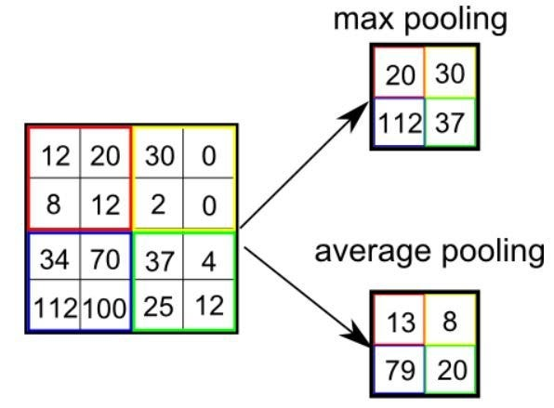
Padding, Stride, and Pooling
Pooling
Types: Max pooling, average pooling
Role in reducing dimensionality
Example: Pooling on an image
Illustration of 3x3 pooling over 5x5 convolved feature (source)

Slide 26
Pooling
When detecting lower-level features, such as edges, we often want our representations to be somewhat invariant to translation. For instance, if we take the image X with a sharp delineation between black and white and shift the whole image by one pixel to the right, i.e., Z[i, j] = X[i, j + 1], then the output for the new image Z might be vastly different. The edge will have shifted by one pixel.
Pooling layers are introduced to serve the dual purposes of mitigating the sensitivity of convolutional layers to location and of spatially downsampling representations.
Unlike the cross-correlation computation of the inputs and kernels in the convolutional layer, the pooling layer contains no parameters. Instead, pooling operators are deterministic, typically calculating either the maximum or the average value of the elements in the pooling window. These operations are called maximum pooling (max-pooling) and average pooling, respectively.

Slide 27
Average Pooling
Average pooling is essentially as old as CNNs. The idea is akin to downsampling an image. Rather than just taking the value of every second (or third) pixel for the lower resolution image, we can average over adjacent pixels to obtain an image with better signal-to-noise ratio since we are combining the information from multiple adjacent pixels.
Notes:
Riesenhuber, M., & Poggio, T. (1999). Hierarchical models of object recognition in cortex. Nature Neuroscience, 2(11), 1019–1025.
Yamaguchi, K., Sakamoto, K., Akabane, T., & Fujimoto, Y. (1990). A neural network for speaker-independent isolated word recognition. First International Conference on Spoken Language Processing.

Slide 28
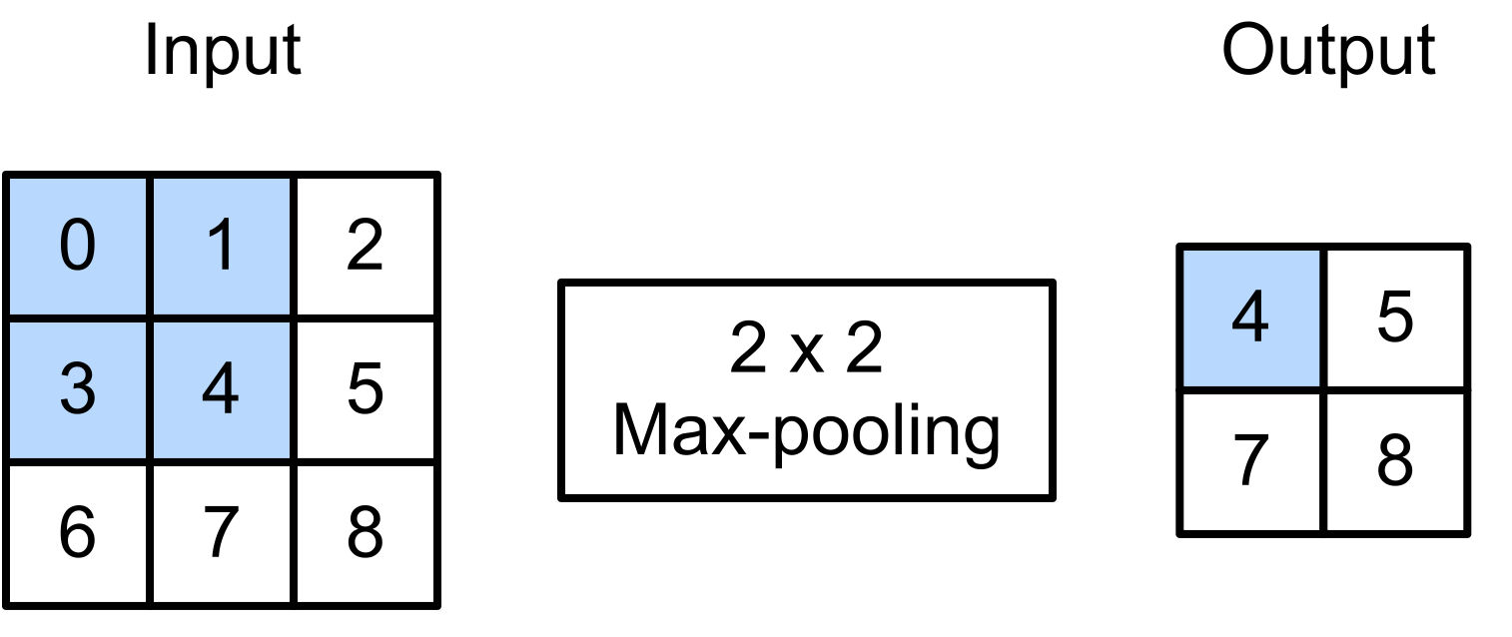
Maximum Pooling
Max-pooling was introduced in Riesenhuber and Poggio (1999) in the context of cognitive neuroscience to describe how information aggregation might be aggregated hierarchically for the purpose of object recognition; there already was an earlier version in speech recognition (Yamaguchi et al., 1990).
In almost all cases, max-pooling is preferable to average pooling.
Consider example:
Notes:
Riesenhuber, M., & Poggio, T. (1999). Hierarchical models of object recognition in cortex. Nature Neuroscience, 2(11), 1019–1025.
Yamaguchi, K., Sakamoto, K., Akabane, T., & Fujimoto, Y. (1990). A neural network for speaker-independent isolated word recognition. First International Conference on Spoken Language Processing.

Slide 29
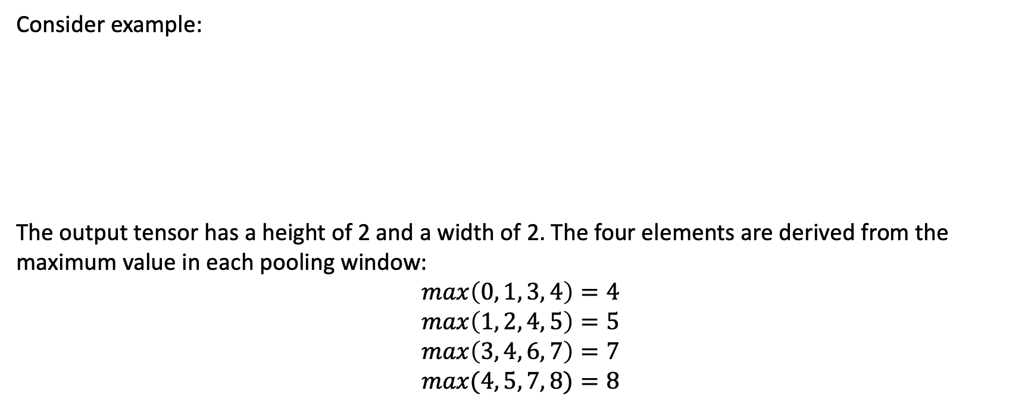
Maximum Pooling
Consider example:
The output tensor has a height of 2 and a width of 2. The four elements are derived from the maximum value in each pooling window:
$$max\left(0, 1, 3, 4\right)=4 \\ max\left(1, 2, 4, 5\right)=5$$
$$max\left(3, 4, 6, 7\right)=7$$
$$max(4, 5, 7, 8)=8$$
Notes:
Riesenhuber, M., & Poggio, T. (1999). Hierarchical models of object recognition in cortex. Nature Neuroscience, 2(11), 1019–1025.
Yamaguchi, K., Sakamoto, K., Akabane, T., & Fujimoto, Y. (1990). A neural network for speaker-independent isolated word recognition. First International Conference on Spoken Language Processing.

Slide 30
Stride
Example code implements the forward propagation of the pooling layer in the pool2d function. Unlike previous corr2d function, since no kernel is needed, we compute the output as either the maximum or the average of each region in the input.
def pool2d(X, pool_size, mode='max'):
p_h, p_w = pool_size
Y = torch.zeros((X.shape[0] - p_h + 1, X.shape[1] - p_w + 1))
for i in range(Y.shape[0]):
for j in range(Y.shape[1]):
if mode == 'max':
Y[i, j] = X[i: i + p_h, j: j + p_w].max()
elif mode == 'avg':
Y[i, j] = X[i: i + p_h, j: j + p_w].mean()
return Y

Slide 31
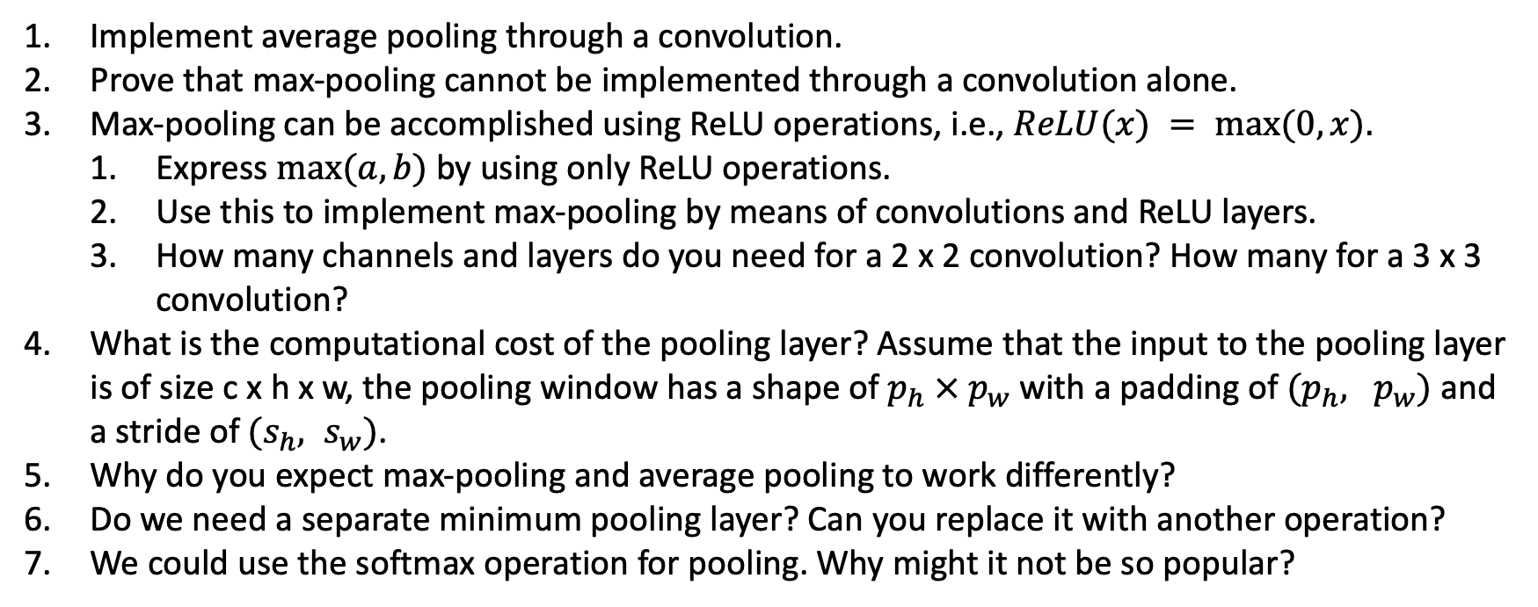
Exercises
Implement average pooling through a convolution.
Prove that max-pooling cannot be implemented through a convolution alone.
Max-pooling can be accomplished using ReLU operations, i.e., $ReLU(x) = max⁡(0,x).$
Express $max⁡(a,b)$by using only ReLU operations.
Use this to implement max-pooling by means of convolutions and ReLU layers.
How many channels and layers do you need for a 2 x 2 convolution? How many for a 3 x 3 convolution?
What is the computational cost of the pooling layer? Assume that the input to the pooling layer is of size c x h x w, the pooling window has a shape of $p_{h} × p_{w}$ with a padding of $(p_{h}, p_{w})$and a stride of$(s_{h}, s_{w})$.
Why do you expect max-pooling and average pooling to work differently?
Do we need a separate minimum pooling layer? Can you replace it with another operation?
We could use the softmax operation for pooling. Why might it not be so popular?

Slide 32
Content
1 Introduction to Convolutional Neural Networks (CNN)
2 2D to 3D CNNs
3 Biomedical Application of CNNs
4 Limitations and Challenges in CNNs for Biomedical Data

Slide 33
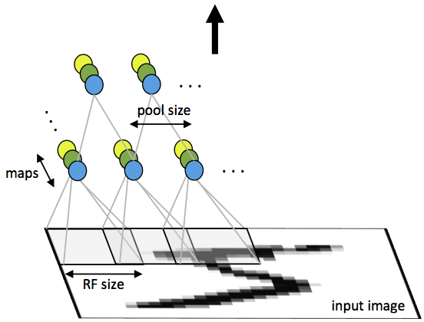
2D CNN
Focus on spatial information
A 2D CNN architecture leverages the 2D structure of input data, such as images or speech signals, through local connections and tied weights, followed by pooling, which creates translation-invariant features. CNNs are also easier to train and require fewer parameters compared to fully connected networks.
Overview of standard applications (e.g., image classification)
First layer of a convolutional neural network with pooling. Units of the same color have tied weights and units of different color represent different filter maps. (source)

Slide 34
Architecture of 2D CNN
A CNN comprises several convolutional and subsampling layers, optionally followed by fully connected layers. The input to a convolutional layer is an m×mxr image, where m is the height and width, and r is the number of channels (e.g., r=3 for an RGB image).
The convolutional layer uses k filters of size n×n×q, where n is smaller than m, and q is either equal to or smaller than r. Each filter generates k feature maps of size m−n+1.
Subsampling (mean or max pooling) is then applied to p×p regions, with p typically ranging from 2 to 5. Bias and nonlinearity are added to the feature maps.
After the convolutional layers, fully connected layers may follow, similar to those in standard neural networks.

Slide 35
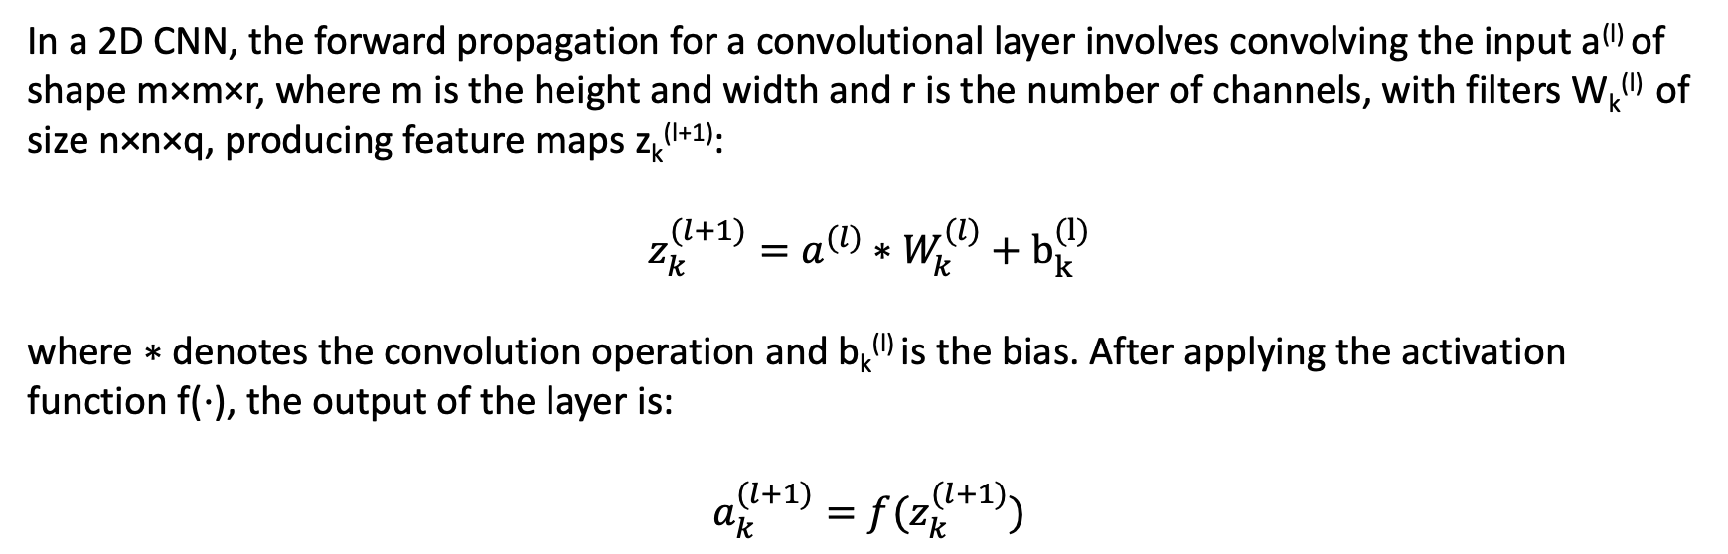
Forward Propagation in 2D CNN
In a 2D CNN, the forward propagation for a convolutional layer involves convolving the input a^{(l)} of shape m×m×r, where m is the height and width and r is the number of channels, with filters W_{k}^{(l)} of size n×n×q, producing feature maps z_{k}^{(l+1)​}:
$$z_{k}^{(l+1)}=a^{(l)}∗W_{k}^{(l)}+b_{k}^{(l)}$$
where ∗ denotes the convolution operation and b_{k}^{(l)} is the bias. After applying the activation function f(⋅), the output of the layer is:
$$a_{k}^{(l+1)}=f(z_{k}^{(l+1)})$$

Slide 36
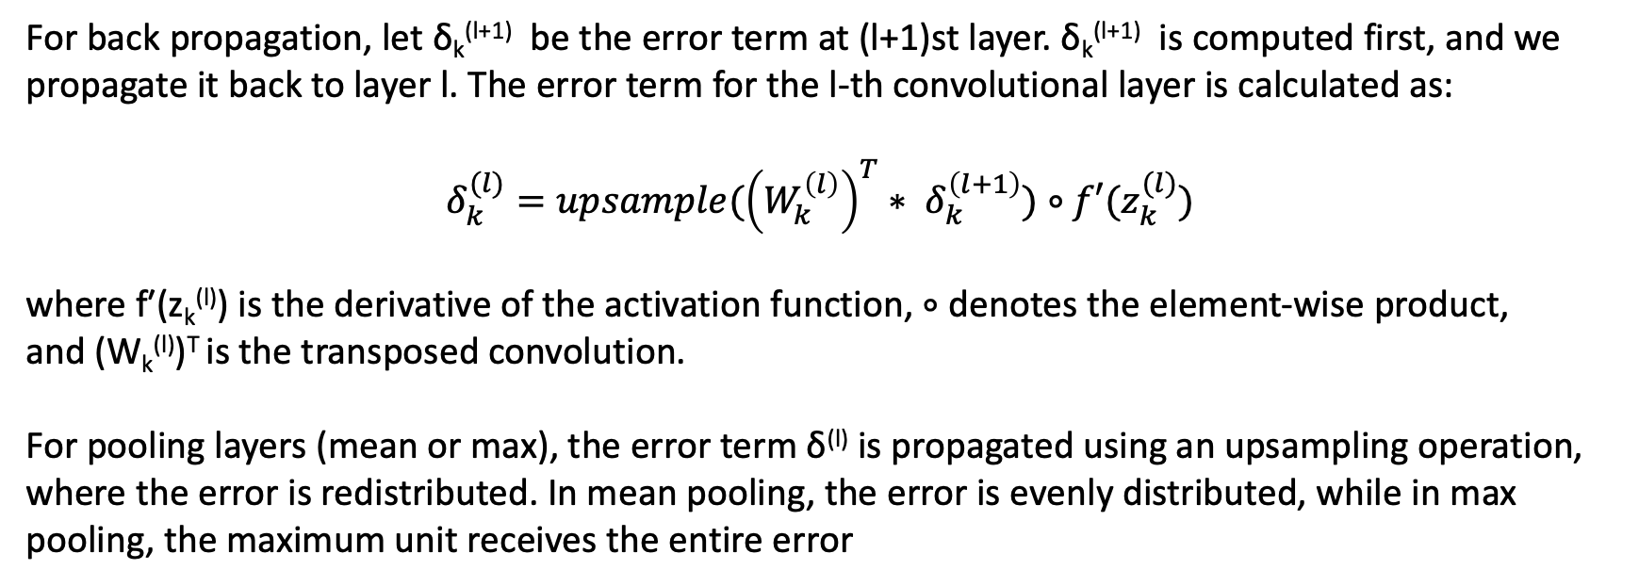
Backward Propagation in 2D CNN
For back propagation, let δ_{k}^{(l+1)} be the error term at (l+1)st layer. δ_{k}^{(l+1)} is computed first, and we propagate it back to layer l. The error term for the l-th convolutional layer is calculated as:
$$δ_{k}^{(l)}=upsample({\left(W_{k}^{\left(l\right)}\right)}^{T}∗ δ_{k}^{\left(l+1\right)})∘f′(z_{k}^{(l)})$$
where f′(z_{k}^{(l)}) is the derivative of the activation function, ∘ denotes the element-wise product, and (W_{k}^{(l)})^{T} is the transposed convolution.
For pooling layers (mean or max), the error term δ^{(l)} is propagated using an upsampling operation, where the error is redistributed. In mean pooling, the error is evenly distributed, while in max pooling, the maximum unit receives the entire error

Slide 37
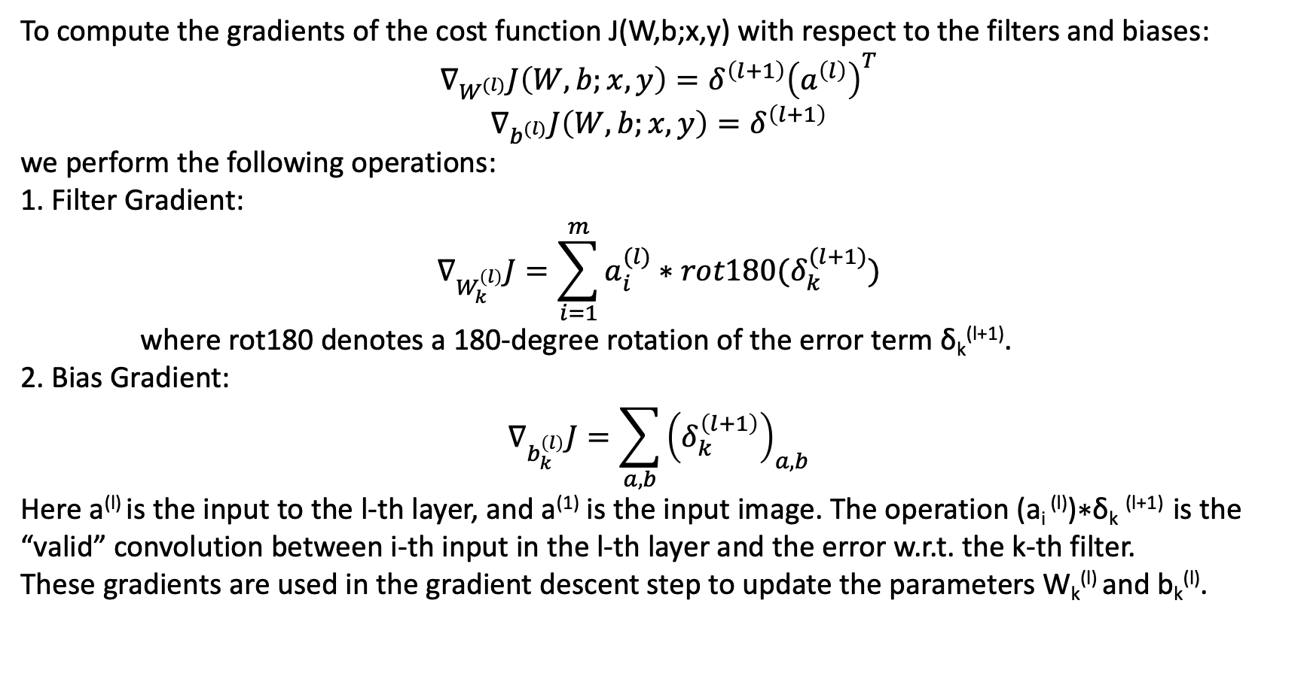
Gradient Calculation in 2D CNN
To compute the gradients of the cost function J(W,b;x,y) with respect to the filters and biases:
$$∇_{W^{(l)}}J\left(W,b;x,y\right)=δ^{\left(l+1\right)}{\left(a^{\left(l\right)}\right)}^{T}$$
$$∇_{b^{(l)}}J\left(W,b;x,y\right)=δ^{\left(l+1\right)}$$
we perform the following operations:
1. Filter Gradient:
$$∇_{W_{k}^{\left(l\right)}}J=\sum_{i=1}^{m}{a_{i}^{(l)}∗rot180(δ_{k}^{(l+1)})}$$
where rot180 denotes a 180-degree rotation of the error term δ_{k}^{(l+1)}​.
2. Bias $\text{Gradient}$:
$$∇_{b_{k}^{\left(l\right)}}J=\sum_{a,b}{{\left(δ_{k}^{\left(l+1\right)}\right)}_{a,b}}$$
Here a^{(l)} is the input to the l-th layer, and a⁽¹⁾ is the input image. The operation (a_{i} ^{(l)})∗δ_{k} ^{(l+1)} is the “valid” convolution between i-th input in the l-th layer and the error w.r.t. the k-th filter.
These gradients are used in the gradient descent step to update the parameters W_{k}^{(l)} and b_{k}^{(l)}.

Slide 38
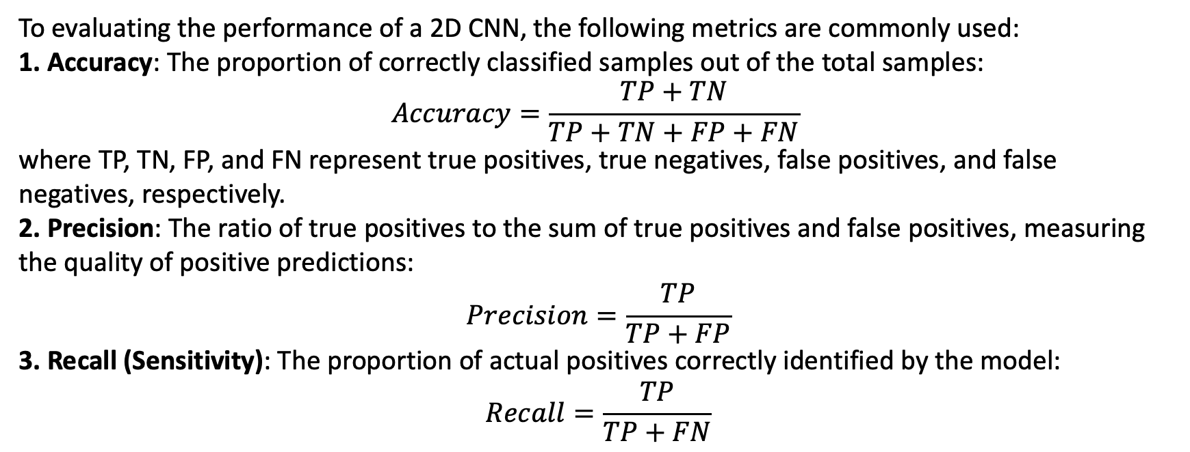
Evaluation Metrics of 2D CNN
To evaluating the performance of a 2D CNN, the following metrics are commonly used:
1. Accuracy: The proportion of correctly classified samples out of the total samples:
$$Accuracy=\frac{TP+TN}{TP+TN+FP+FN}$$
where TP, TN, FP, and FN represent true positives, true negatives, false positives, and false negatives, respectively.
2. Precision: The ratio of true positives to the sum of true positives and false positives, measuring the quality of positive predictions:
$$Precision=\frac{TP}{TP+FP}$$
3. Recall (Sensitivity): The proportion of actual positives correctly identified by the model:
$$Recall=\frac{TP}{TP+FN}$$

Slide 39
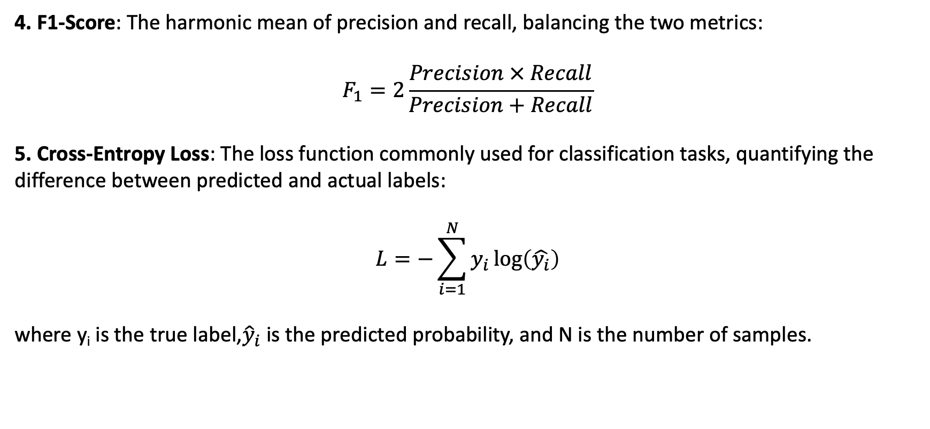
Evaluation Metrics of 2D CNN
4. F1-Score: The harmonic mean of precision and recall, balancing the two metrics:
$$F_{1}=2\frac{Precision × Recall}{Precision+Recall}$$
5. Cross-Entropy Loss: The loss function commonly used for classification tasks, quantifying the difference between predicted and actual labels:
$$L=−\sum_{i=1}^{N}{y_{i}\log\left(\hat{y_{i}}\right)}$$
where y_{i} is the true label,${\hat{y}}_{i}$​ is the predicted probability, and N is the number of samples.

Slide 40
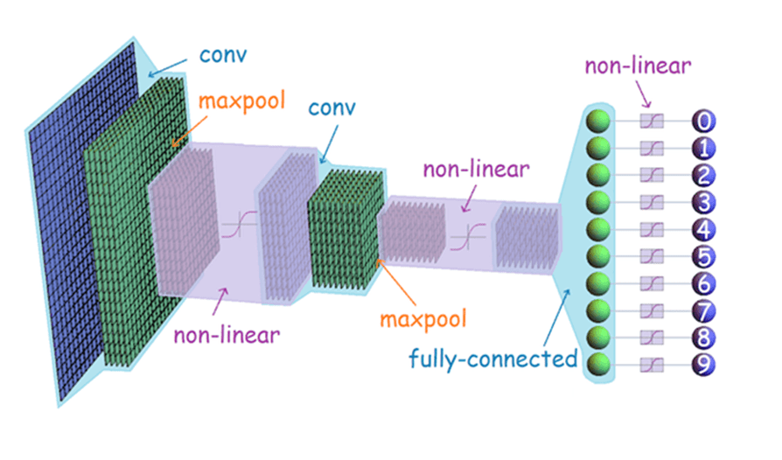
Intro to 3D CNN
Focus on volumetric or temporal information
3D Convolutional Neural Networks (3D CNNs) extend the functionality of 2D CNNs by operating on three-dimensional input data.
While 2D CNNs process spatial information in two dimensions (height and width), 3D CNNs add a third dimension, allowing them to capture volumetric or temporal information.
Overview of standard applications (e.g., video sequences or 3D medical imaging)
A 3D CNN architecture. (source: Handwritten Digit Recognition Using CNN with Keras)

Slide 41
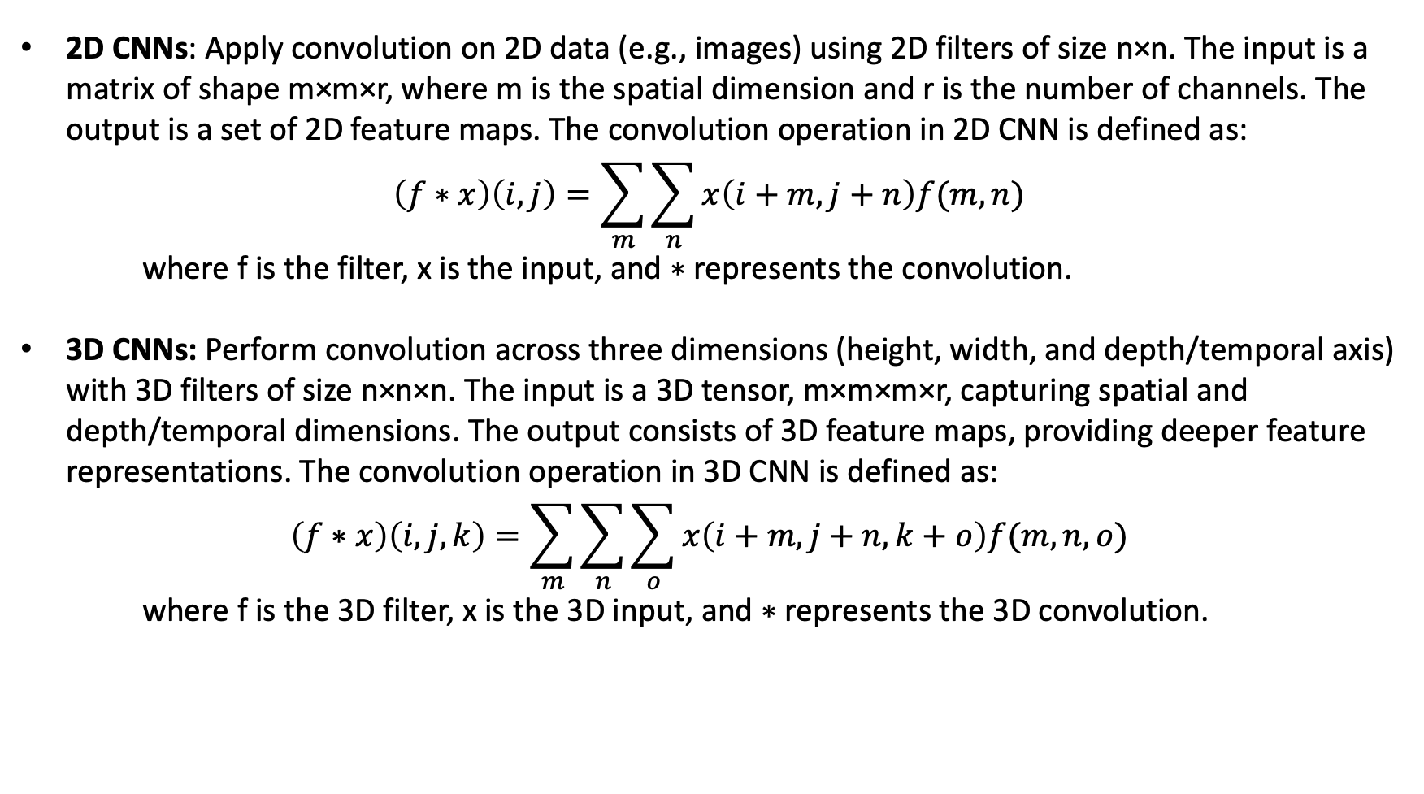
Difference Between 2D and 3D CNNs
2D CNNs: Apply convolution on 2D data (e.g., images) using 2D filters of size n×n. The input is a matrix of shape m×m×r, where m is the spatial dimension and r is the number of channels. The output is a set of 2D feature maps. The convolution operation in 2D CNN is defined as:
$$\left(f∗x\right)\left(i,j\right)=\sum_{m}{\sum_{n}{x\left(i+m,j+n\right)f(m,n)}}$$
where f is the filter, x is the input, and ∗ represents the convolution.
3D CNNs: Perform convolution across three dimensions (height, width, and depth/temporal axis) with 3D filters of size n×n×n. The input is a 3D tensor, m×m×m×r, capturing spatial and depth/temporal dimensions. The output consists of 3D feature maps, providing deeper feature representations. The convolution operation in 3D CNN is defined as:
$$\left(f∗x\right)\left(i,j,k\right)=\sum_{m}{\sum_{n}{\sum_{o}{x\left(i+m,j+n,k+o\right)f(m,n,o)}}}$$
where f is the 3D filter, x is the 3D input, and ∗ represents the 3D convolution.

Slide 42
Biomedical Applications for 3D CNNs
Medical Imaging: 3D CNNs are highly effective for analyzing volumetric data from medical imaging modalities, such as MRI, CT scans, or PET scans, where the input data are three-dimensional. For example, in brain MRI, a 3D CNN can capture the spatial relationships between different brain regions and predict clinical outcomes.
Alzheimer’s Disease Prediction: By using 3D CNNs, researchers can analyze 3D brain scans to detect subtle structural changes associated with Alzheimer’s disease (AD).
Tumor Detection: In 3D CT or MRI scans, 3D CNNs can identify tumors by learning volumetric patterns within the body, aiding in early diagnosis and treatment planning.
Functional Connectivity Analysis: In neuroscience, 3D CNNs are employed to analyze 4D functional MRI data (3D + time), helping to map brain connectivity and investigate conditions such as autism or schizophrenia.

Slide 43
Content
1 Introduction to Convolutional Neural Networks (CNN)
2 2D to 3D CNNs
3 Biomedical Application of CNNs
4 Limitations and Challenges in CNNs for Biomedical Data

Slide 44


Clinical Outcome Data Application: ADNI and UK Biobank (UKB)
Overview of the ADNI and UKB Datasets
ADNI (Alzheimer's Disease Neuroimaging Initiative):
A longitudinal dataset focused on Alzheimer’s disease (AD) and mild cognitive impairment (MCI).
Contains multimodal imaging data such as MRI, PET, and genetic information, as well as clinical assessments (e.g., Mini-Mental State Examination, MMSE).
Aims to investigate biomarkers for AD progression.
UK Biobank (UKB):
A large-scale biomedical dataset with imaging (MRI, DTI) and extensive clinical data, including cognitive performance measures.
It includes brain imaging and cognitive assessments such as fluid intelligence, which measures problem-solving ability.
Both datasets provide rich information for studying neurodegenerative diseases and cognitive health, making them ideal for predictive modeling using CNNs.

Slide 45
Clinical Outcomes of Interest
AD Proxy:
A clinical outcome used as a surrogate marker for Alzheimer’s disease progression.
ADNI provides imaging data linked to AD diagnosis, cognitive decline, and biomarkers, allowing prediction of AD severity based on neuroimaging patterns.
Fluid Intelligence Score:
Measured in UKB, it reflects cognitive abilities such as reasoning, problem-solving, and memory.
It serves as a measure of overall cognitive health and is associated with neurological conditions like dementia.
Mini-Mental State Examination (MMSE):
A widely used tool in ADNI for assessing cognitive impairment.
Scores range from 0 to 30, with lower scores indicating greater cognitive impairment.
CNN models can predict MMSE scores using imaging data to detect early signs of cognitive decline.

Slide 46
Why CNNs Are Suited for This Type of Data
CNNs are highly effective for analyzing imaging data due to their ability to automatically learn hierarchical features from raw input.
In the context of ADNI and UKB, CNNs are particularly well-suited for:
Handling High-Dimensional Data: Imaging data, such as MRI scans, are high-dimensional, with spatial dependencies that CNNs can efficiently capture through convolutional layers. The convolution operation extracts local features from the input data, reducing the need for manual feature engineering.
Spatial Feature Extraction: From measures like hippocampal volume or cortical thickness, CNNs can identify spatial patterns related to AD progression. For example, subtle structural changes in the brain can be detected and used to predict cognitive decline.

Slide 47
Why CNNs Are Suited for This Type of Data
Multimodal Integration: Both ADNI and UKB include various data modalities (imaging, genetic, clinical). CNNs can be extended to integrate multiple data types, such as combining MRI scans with clinical outcomes, for more robust AD predictions.
Nonlinear Relationships: Clinical outcomes, such as fluid intelligence or AD progression, often involve complex, nonlinear relationships between variables (e.g., brain structure and cognition). CNNs, through their deep architectures, can model these nonlinearities effectively, improving prediction accuracy.

Slide 48
Content
1 Introduction to Convolutional Neural Networks (CNN)
2 2D to 3D CNNs
3 Biomedical Application of CNNs
4 Limitations and Challenges in CNNs for Biomedical Data

Slide 49
Limited Annotated Data
Scarcity of Labeled Data
Annotating biomedical images requires expert knowledge.
Limited availability of labeled datasets for training.
High Annotation Costs
Time-consuming and expensive to label data.
Limits the size of training datasets.

Slide 50
Data Variability and Heterogeneity
Inter-Patient Variability
Significant differences between patients.
Variations in anatomy, pathology, and imaging conditions.
Equipment and Protocol Differences
Different imaging devices produce varying image qualities.
Protocols differ between institutions.

Slide 51
Class Imbalance
Rare Conditions
Low prevalence for some diseases or abnormalities
Leads to imbalanced datasets with few positive samples.
Impact on Training
Models may become biased toward majority classes.
Difficulty in learning from minority class samples.

Slide 52
Interpretability and Explainability
Black-Box Models
CNNs lack transparency in decision-making processes.
Challenges in gaining clinical trust and acceptance.
Regulatory Requirements
Necessity for explainable AI in medical applications.
Compliance with ethical standards and regulations.

Slide 53
Generalization and Transferability
Domain Shift
Models may not generalize well to new datasets.
Differences in data distributions affect performance.
Need for Robust Models
Importance of models that perform well across diverse datasets.
Techniques like transfer learning and domain adaptation are essential.

